Slide 1
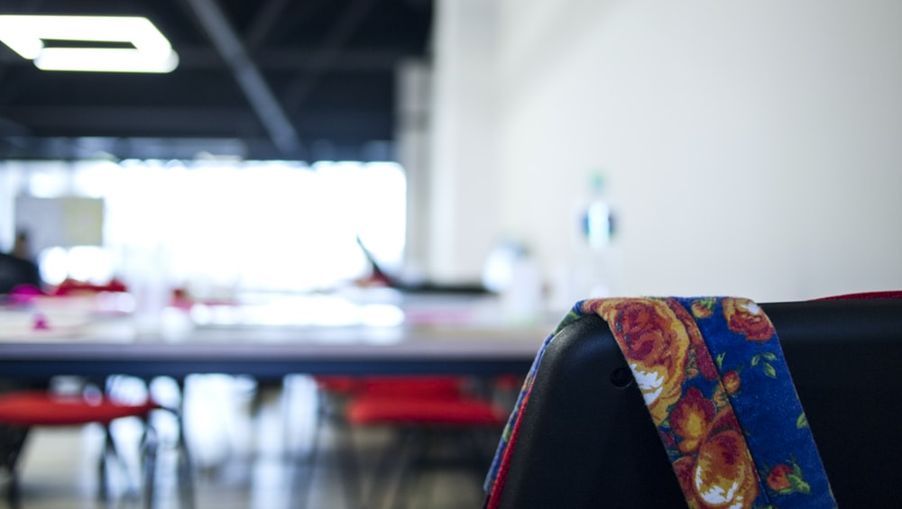
WELCOME TO NINFA
A House of Creation & Quality of Clothings
Since 2009

Slide 2
Who we are
Ninfa Textiles is a company of clothing sourcing and quality control service for our buyers with operational headquarters in Dhaka, the capital of Bangladesh since 2009. Our factory is located 5 minutes by car from the international airport, in Uttara area, 60 Gawsul Azam Avenue.
Our team is composed of young, dynamic, passionate and competent people. We are a professional and valid team. This is a prerequisite for success. For each project, under the supervision of a production manager, quality controllers, laboratory technicians, shippers and customs experts work.
The uncompromising attention to quality and accuracy of delivery are two points of our strength of Ninfa.
WHAT MAKES US BE UNIQUE
We believe in “PROFESSIONAL PARTNERSHIP” . A professional service for our customers. Always. Their constant satisfaction is our goal.
Complete Supply Chain Management:
Fashion Design for the Collection
Search for raw materials
Product Development
Negotiation of the Order
Product Development
Choice of suitable factories
Choice of the right raw materials
Production Planning
Work supervision in progress
Manufacture control
Real-time production update
Quality Assurance
Code of Conduct and Responsibility
Export Documentation
Logistics solutions for transport
After-sales service
Recognition of compensation for commercial damages if there are any.
02

Slide 3
AT A GLANCE
02

Slide 4
Supply Chain
Management
02

Slide 5
WHY TO CHOOSE US
02

Slide 6
YOU NEED NINFA IF
If you are looking for the answer to your production needs from Bangladesh or other countries.
If you want to spend some of your productions in Bangladesh, but haven't found the right partner.
If the sampling also arrives in due time, with respect to the agreed deadlines.
If you want to monitor the activity, or some of its most important points, leaving an expert in Bangladesh to manage the productions requested by you there.
If you do not want to spend your precious time communicating with many different suppliers in Bangladesh, but make the best solution for solving your various problems.
If you are looking for a stable business relationship with some manufacturers you can trust for their quality of services, products and prices.
If you need high quality and innovative products.
If you are always looking for new product updates, samples, etc., in order to establish or maintain economies of scale and drastically reduce costs.
So, if you are looking for a window that looks out upon the solution of all your needs matching a qualitative purchase, you can give us an opportunity and you will soon wonder why you have succeeded without us so far.
03

Slide 7
PRODUCTS
WHAT WE OFFER
PRODUCT RANGE :
MENS WEAR (Polo, T-Shirt, Felpe, Shirts, Trouser, Bermuda, Denim Pants, Sweaters, Bomber Jacket)
LADIES WEAR (Polo, T-Shirt, Felpe, Shirts, Trouser, Bermuda, Denim Pants, Sweaters)
KIDS WEAR (Polo, T-Shirt, Felpe, Shirts, Trouser, Bermuda, Denim Pants, Sweaters)
Polo | T-Shirt | Felpe
Shirts | Sweaters | Jackets
Trouser | SUPIMA | Denim Pants
RAW MATERIALS WE USE:
100% Cotton, Mix Poly-Cotton (Jersey, Supima, Pique, Interlock Frech Terry, Polar Fleece, Gabardin, Twill, Poplin, Dobby, Denim, Taffetta, Mash etc.)
QUALITY
It is our concern to carefully evaluate the factories with which we conduct productions, as there are also aspects at heart:
Child labor, forced labor.
Health and hygiene.
Adequate fire protection system structures, "Fire Escap" system etc.
Environmental pollution control.
Control recognition as: "ISO 9001: 2000", "Oeko-tex Standard 100", "WRAP" "GOTS and" FAIRTRADE "-
We are always behind our words, no stories, no excuses!
Our quality control system is able to provide any information on the state of production you need, we leave no place for any error.
SERVICE
We believe that the best service makes the business world better. We offer a competitive level of Customer Service. Our office - made up of several teams of enthusiastic and experienced people is always ready to help you and find an effective and creative solution.
04

Slide 8
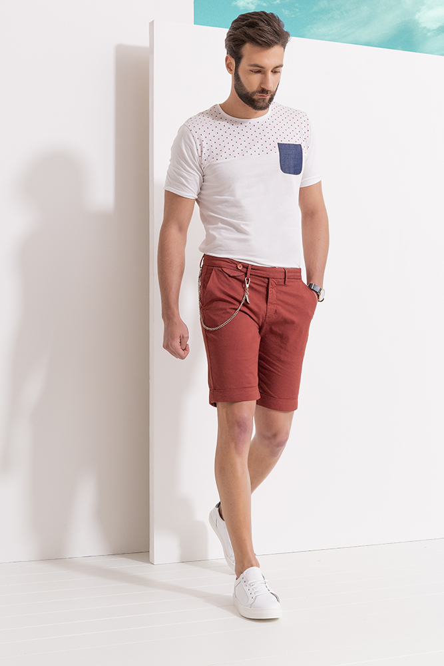
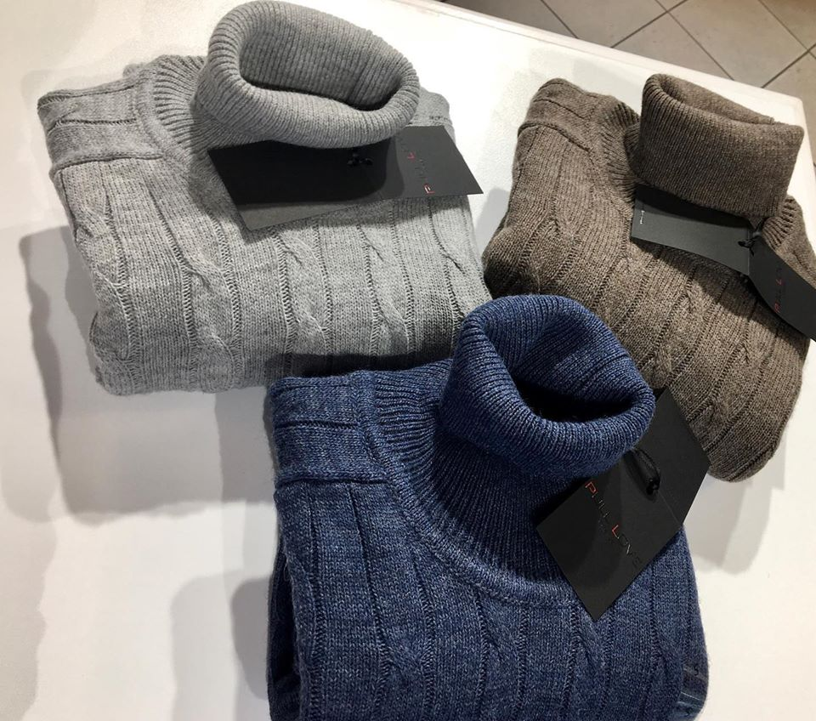
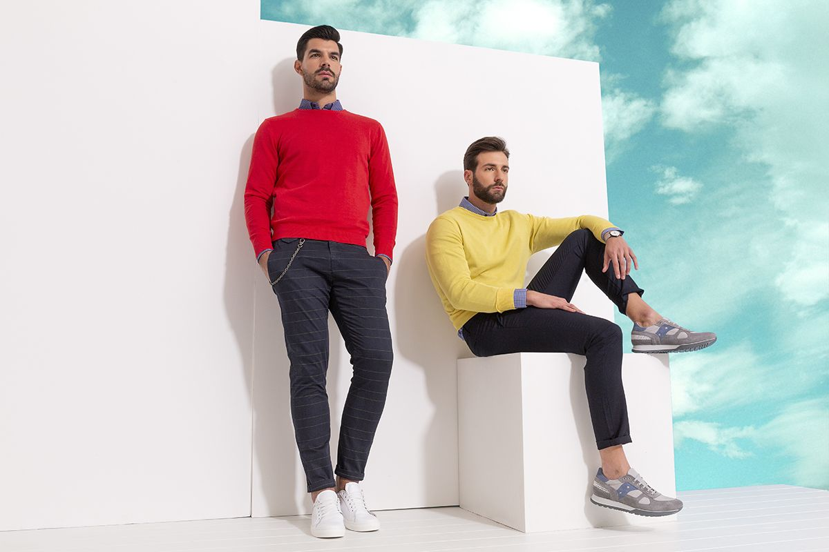
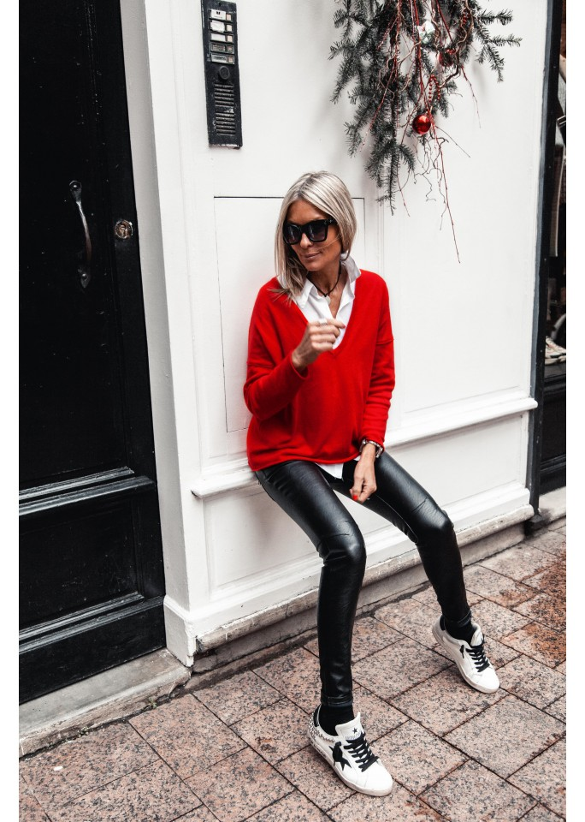
PHOTO GALARY
02

Slide 9
MANUFACTURING UNIT
We have our own Manufacturing Unit called DIAMOND ATTRIERS LTD.
ADDRESS:
MENS WEAR (Polo, T-Shirt, Felpe, Shirts, Trouser, Bermuda, Denim Pants, Sweaters, Bomber Jacket)
LADIES WEAR (Polo, T-Shirt, Felpe, Shirts, Trouser, Bermuda, Denim Pants, Sweaters)
KIDS WEAR (Polo, T-Shirt, Felpe, Shirts, Trouser, Bermuda, Denim Pants, Sweaters)
RAW MATERIALS WE USE:
100% Cotton, Mix Poly-Cotton (Jersey, Supima, Pique, Interlock Frech Terry, Polar Fleece, Gabardin, Twill, Poplin, Dobby, Denim, Taffetta, Mash etc.)
QUALITY
It is our concern to carefully evaluate the factories with which we conduct productions, as there are also aspects at heart:
Child labor, forced labor.
Health and hygiene.
Adequate fire protection system structures, "Fire Escap" system etc.
Environmental pollution control.
Control recognition as: "ISO 9001: 2000", "Oeko-tex Standard 100", "WRAP" "GOTS and" FAIRTRADE "-
We are always behind our words, no stories, no excuses!
Our quality control system is able to provide any information on the state of production you need, we leave no place for any error.
SERVICE
We believe that the best service makes the business world better. We offer a competitive level of Customer Service. Our office - made up of several teams of enthusiastic and experienced people is always ready to help you and find an effective and creative solution.
04

Slide 10
OVERVIEW
EXPERIENCE
In the past few years we have worked and work mostly with Italian customers and we can say that we are a loyal company as a trusted supplier for some customers.
PULL LOVE, as the first Italian name. We are the only agent / quality control for the Arezzo Brand PULL LOVE. Harmont & Blaine Junior by Casandrino. This is why we feel we have the right experience that you were probably looking for.
VISIONS
Customer satisfaction is our vision. To provide the best quality, the highest performance, we adopt production procedures characterized by a systematic work style aimed at achieving excellence and timeliness.
We enjoy an effective professional relationship between the buyer, employees and management.
WARRANTY
We take care of the service of the superior guarantee to our Customers, for example taking the responsibility of after sales. We can only say: put us to the test!
PRICE
With our "Vertical Integrated Production Solution", nobody can beat our prices especially when compared to the quality you will get..
OUR CURRENT AND PAST CUSTOMERS:
Italy:
PL Retails Spa, AGB Company Spa, Colella Srl, Ruta Group, In.com Spa, Dream Project Spa, Fenicia Spa, Compar Spa.
Poland:
LPP SA, Monnari Trade SA.
05

Slide 11
OUR BUYERS
06

Slide 12
OUR CONTACTS
NINFA Textiles Ltd.
60, Gawsul Azam Avenue, Sector:13,
Uttara 1230, Dhaka | Bangladesh.
+880 255086607 https://www.nifatextiles.com/
SUMAN SAHA
Managing Director
+88 01726954275 +39 327 6789 779
suman@nifatex.com
SHAKILA BOBBY (CHAIRMAN)
+88 01957797876 +39 388 4665683
shakila@nifatex.com
https://www.facebook.com/GruppoNifa/?ref=embed_page
https://www.linkedin.com/in/ninfa-textiles-ltd-69446b48/?locale=en_US
Youtube
Ninfa Textilse Ltd (Sourcing & Inspection Services)
Golden Attires Fashion Ltd (Manufacture Unit) Gruppo Nifa Srl (Production, Import & Export )
07

Slide 13
FAQ
1.Q: Can we get the sample for reference?
A: Samples can be sent to you to check the quality, fittings and color fastness.
2.Q: May I get a cheaper price?
A: A cheaper price will be given if there is a large quantity you need.
3.Q: Can you visit us?
A: Certainly! If you give us an appointment to visit you and make quotation for your next orders.
4.Q: Do you Provide Product Developments?
A: Yes! We have our own design team including Italian Designers to offer PD services for the next Season.
5.Q: Can I visit you?
A: Sure, our company situated in Dhaka, Bangladesh and we welcome visitors here from all over the world. If you would like to visit us or our manufacturing facilities, then this can be organized by us with Free Car and chauffeur service. If you want us to book hotel for your pleasant stay at Dhaka we can do it and we have 40% discount on all 5 stars hotels in Bangladesh.
08

Slide 14
THANK YOU FOR DEDICATING YOUR PRECIOUS TIME !
OUR TEAM OF NINFA
CORDIALY THANK YOU.
08

Slide 15
THANK YOU
GRAZIE
MERCI
DANKE
GRACIAS
БЛАГОДАРЮ ВАС
धन्यवाद - ধন্যবাদ
谢谢 Xièxiè
08

